Slide 1
MACHINE LEARNING INTERNSHIP PROJECT
Presented By – Malaya Kumar Pradhan

Slide 2
Content
Heart Disease Prediction
Lung Cancer Prediction
Mobile Phone Price Prediction
Thyroid Cancer Prediction

Slide 3

HEART DISEASE PREDICTION

Slide 4
INTRODUCTION
Heart disease remains a leading cause of mortality worldwide. Early detection is critical for effective treatment and prevention. This project leverages machine learning to predict the likelihood of heart disease based on clinical and demographic data, offering a data-driven decisions.

Slide 5
PROBLEM STATEMENT
Cardiovascular disease is the leading cause of death globally.
Early detection can significantly reduce mortality.
Goal: Predict heart disease using clinical data and machine learning.

Slide 6
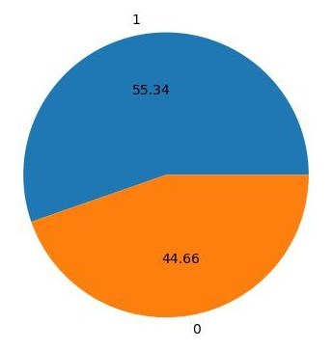
Dataset OVERVIEW
918 patient records, 12 clinical features
Removed duplicate rows to ensure data integrity
Target : Presence(1) or absence(0) of heart disease

Slide 7
PREPROCESSING TECHNIQUES
Outlier Handling :-
Resting BP and Cholesterol :- Interquartile Range (IQR)
Oldpeak :- IQR + Function Transformer
Distribution Correction :-
Cholesterol and Max Heart Rate : - Power Transformer
Scaling :-
Resting BP :- Normalized scaling (0-1 range)

Slide 8
MODELlING APPROACHES
Gradient Boosting Classifier
Logistic Regression
Decision Tree Classifier
Random Forest Classifier
Each model trained on the same preprocessed dataset for fair comparison.

Slide 9
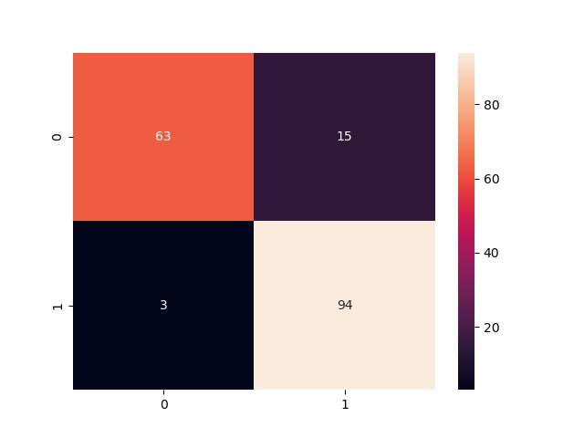
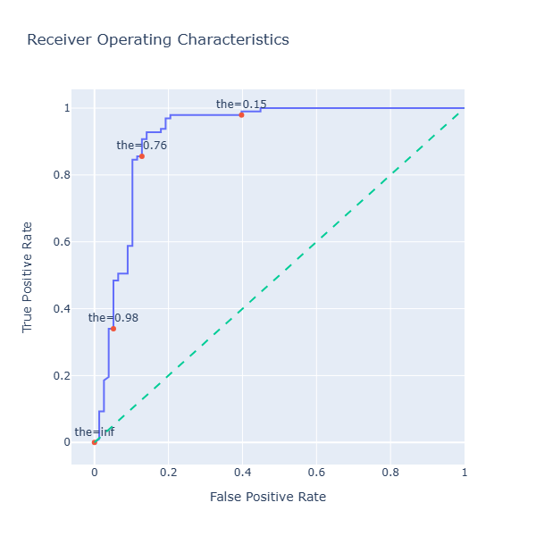
GRADIENT BOOSTING PERFORMANCE OVERVIEW
Accuracy :- 89.71%
Precision :- 86.24%
Recall : - 96.90%

Slide 10
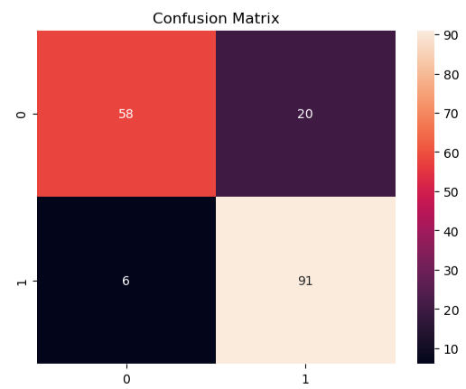
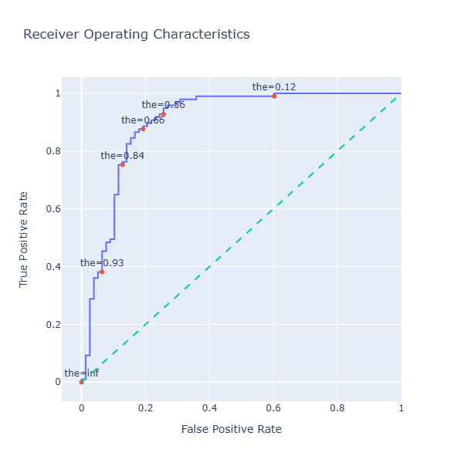
LOGISTIC REGRESSION PERFORMANCE OVERVIEW
Accuracy : - 85.14%
Precision : - 81.98%
Recall : - 93.81%

Slide 11
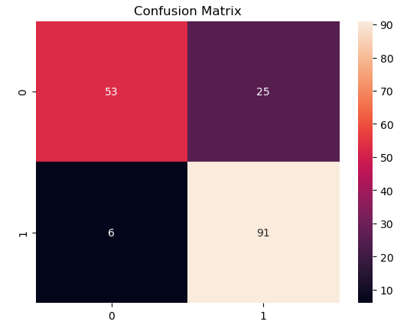
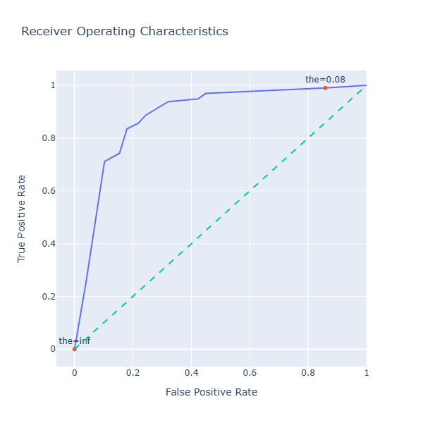
DECISIONTREE CLASSIFIER PERFORMANCE OVERVIEW
Accuracy : - 82.28%
Precision : - 78.45%
Recall : - 93.81%

Slide 12
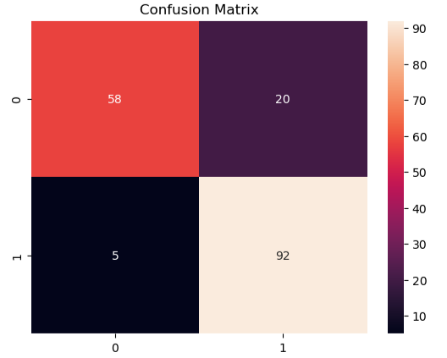
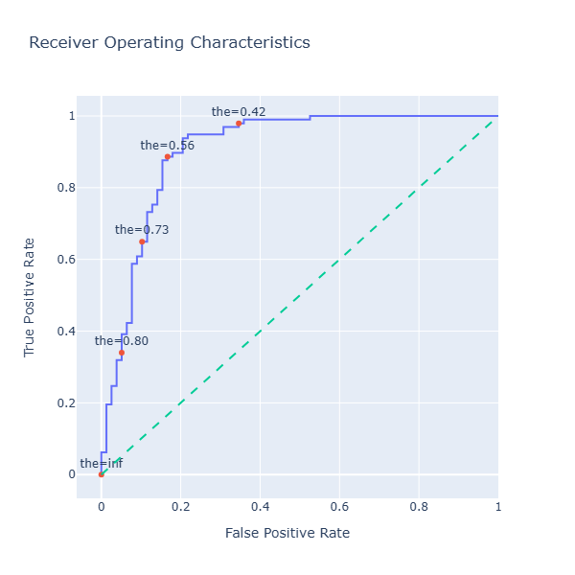
RANDOMFOREST CLASSIFIER PERFORMANCE OVERVIEW
Accuracy : - 85.71%
Precision :- 82.14%
Recall : - 94.84%

Slide 13
MODEL COMPARISON
Model | Accuracy | Precision | Recall
Gradient Boosting | 89.71% | 86.24% | 96.90%
Logistic Regression | 85.14% | 81.98% | 93.81%
Decision Tree classifier | 82.28% | 78.45% | 93.81%
Random Forest Classifier | 85.71% | 82.14% | 94.84%

Slide 14
CONCLUSION
Gradient Boosting delivered the best performance, especially in recall.
Preprocessing played a key role in improving model accuracy.
High recall ensures fewer missed diagnoses-critical in healthcare.

Slide 15
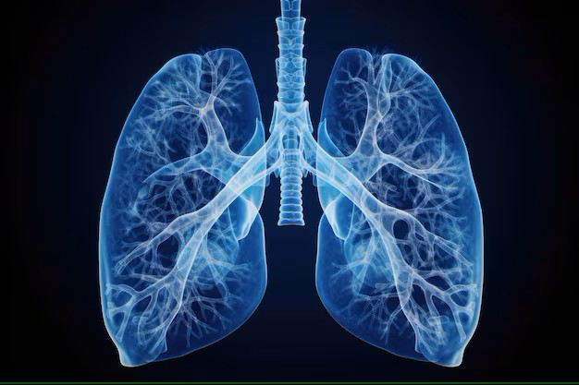
LUNG CANCER PREDICTION

Slide 16
INTRODUCTION
Lung cancer is one of the deadliest cancers globally, with early detection being critical for improving survival rates. This project aims to develop a machine learning pipeline that predicts patient survival outcomes based on clinical, demographic, and engineered features.

Slide 17
PROBLEM STATEMENT
Lung cancer is a leading cause of cancer-related deaths worldwide.
Early prediction can significantly improve survival outcomes.
Goal: Build a predictive model using clinical and demographic data.

Slide 18
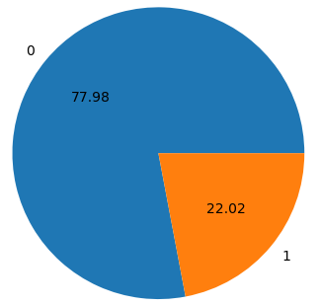
DATASET OVERVIEW
Features: Age, Gender, Country, Diagnosis Date, Cancer Stage, Family History, Smoking Status, BMI , Cholesterol Level, Hypertension, Asthma, Cirrhosis, Other Cancer, Treatment Type, End Treatment Date, Survived
Target: Survival outcome

Slide 19
FEATURE ENGINEERING
Converted categorical features using Ordinal Encoding :-
Cancer stage, Smoking status, Treatment type, Gender, Family history, Country
Derived features :-
Age at diagnosis and end of treatment
Cancer risk score, Smoke-cholesterol index, Metabolic risk, Adjusted survival index, Smoking cancer factor

Slide 20
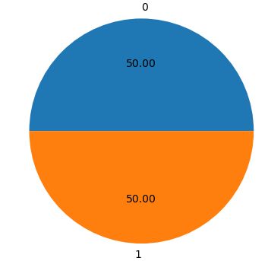
Data PREPROCESSING
Converted BMI and cholesterol level to classification labels
Dropped low-importance features :-
Cancer stage, Cholesterol level, Cancer risk score, Smoking cholesterol index, Smoking status
Applied SMOTE to balance the training set

Slide 21
MODELING APPROACHES
CatBoost Classifier: It is an open source gradient boosting algorithms by Yandex. It provides a high performance implementation of gradient boosting algorithms, with support for categorical features and automation handling of missing values
XGBoost Classifier: It is a powerful and scalable machine learning algorithm known for its efficiency and high performance. It’s an optimized implementation of gradient boosting , a type of ensemble learning that combines multiple weak models to create a stronger , more accurate model.
Voting Classifier: It is an ensemble method that combines predictions from multiple base classifiers to produce a final output. It works by aggregating the predictions of different models and making a final decision based on a majority vote or averaging probabilities.

Slide 22
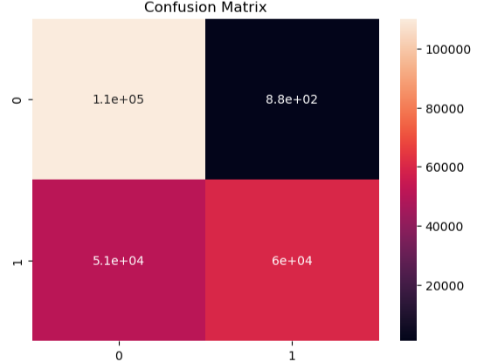
CATBOOST CLASSIFIER PERFORMANCE OVERVIEW
Accuracy : - 76.53%
Precision :- 98.54%
Recall :- 53.86%

Slide 23
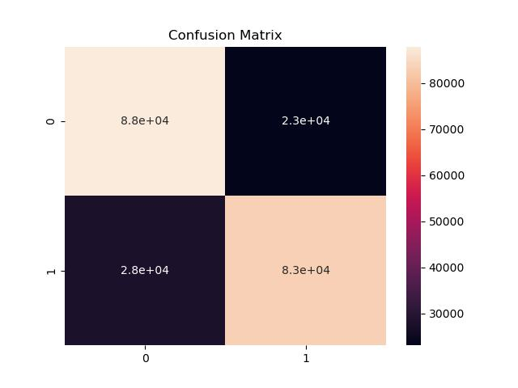
XGBOOST CLASSIFIER PERFORMANCE OVERVIEW
Accuracy :- 77.06%
Precision : - 78.28%
Recall : - 74.91%

Slide 24
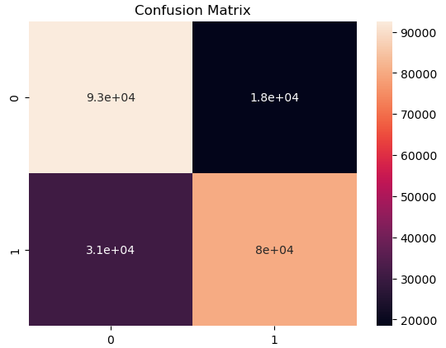
VOTING CLASSIFIER PERFORMANCE OVERVIEW
Accuracy : - 77.85%
Precision : - 81.32%
Recall : - 72.31%

Slide 25
Model COMPARISON
Model | Accuracy | Precision | Recall
CatBoost Classifier | 76.53% | 98.54% | 53.86%
XGBoost Classifier | 77.06% | 78.28% | 74.91%
Voting Classifier | 77.85% | 81.32% | 72.31%

Slide 26
CONCLUSION
Voting Classifier offered the best balance of precision and recall.
Feature engineering and SMOTE significantly improved model robustness.

Slide 27

MOBILE PHONE PRICE PREDICTION

Slide 28
INTRODUCTION
The mobile phone industry is highly competitive, with pricing influenced by a wide range of technical specifications. Predicting the price category of a mobile device based on its features can help manufacturers optimize product placement and assist consumers in making informed decisions. This project aims to build a classification model that predicts the price range of a mobile phone using machine learning techniques.

Slide 29
PROBLEM STATEMENT
The mobile phone market is saturated with diverse models and specifications.
Predicting price categories based on features helps manufacturers and consumers make informed decisions.
Goal: Build a classification model to predict mobile phone price range using machine learning.

Slide 30
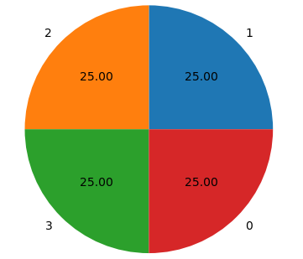
DATASET OVERVIEW
Features include: Battery power, Blue, Clock speed, Dual sim, Front camera, 4G, Internal memory, Mobile depth, Mobile weight, N cores, Primary camera, Pixel height, Pixel width, Ram, Screen height, Screen width, Talk time, 3G, Touch screen, Wi-Fi, Price range
Target: Mobile phone price (e.g. low cost, medium cost, high cost, very high cost)
Dataset is balanced and preprocessed for classification

Slide 31
MODEL SELECTION
Logistic Regression :- baseline linear model
Decision Tree :- interpretable, non-linear classifier
Random Forest :- ensemble method for improved accuracy

Slide 32
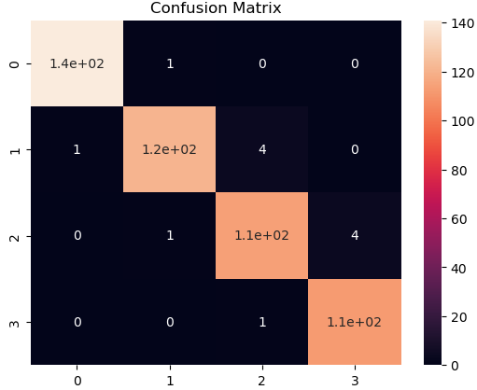
Logistic regression results
Accuracy :- 97.60%
Precision :- 97.50%
Recall :- 97.56%
Insight :- Excellent performance with minimal overfitting.

Slide 33
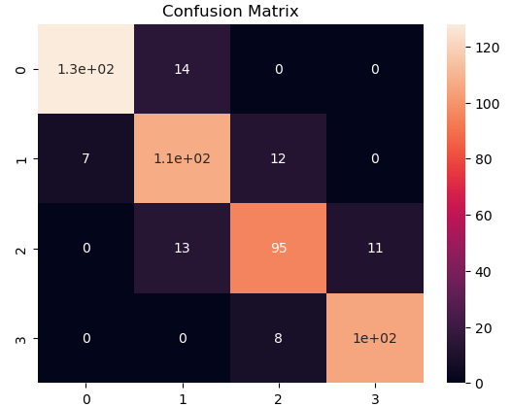
Decision tree results
Accuracy :- 87.00%
Precision :- 86.95%
Recall :- 86.95%
Insight :- Fast and interpretable, but slightly less accurate.

Slide 34
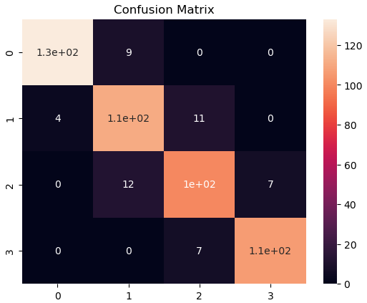
Random forest results
Accuracy :- 90.00%
Precision :- 89.93%
Recall :- 89.90%
Insight :- Strong generalization and better than Decision Tree

Slide 35
Model comparison
Model | Accuracy | Precision | Recall
Logistic Regression | 97.60% | 97.50% | 97.56%
Decision Tree Classifier | 87.00% | 86.95% | 86.95%
Random Forest Classifier | 90.00% | 89.93% | 89.90%

Slide 36
Conclusion
Logistic Regression achieved the highest accuracy and recall.
Random Forest offers a good trade-off between performance and interpretability.

Slide 37

Thyroid cancer detection

Slide 38
introduction
Thyroid cancer is one of the most common endocrine malignancies, and early detection is crucial for improving patient outcomes. This project aims to develop a machine learning pipeline that predicts thyroid cancer outcomes using clinical, demographic, and pathological features.

Slide 39
Problem statement
Thyroid cancer is a growing global health concern.
Early prediction can improve treatment outcomes and reduce recurrence.
Objective :- Build a predictive model using clinical and diagnostic features.

Slide 40
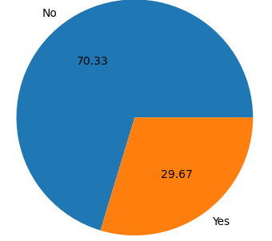
Dataset overview
Clinical dataset with patient demographics, diagnostic history, and cancer staging
Removed duplicate rows to ensure data integrity
Converted ‘Age’ into categorical bins for better interpretability

Slide 41
Feature engineering
Ordinal Encoding applied to :-
Gender, Smoking, Hx Smoking, Hx Radiotherapy
Thyroid Function, Physical Examination, Adenopathy
Pathology, Focality, Risk, T, N, M, Stage, Response, Recurred
Age converted into categorical feature

Slide 42
Modelling approaches
Decision Tree Classifier :- It is a supervised learning algorithm that uses a tree-like structure to classify data instances based on their feature values.
Random Forest classifier :- It is a machine learning algorithm that uses an ensemble of decision trees to classify data. It works by building multiple decision trees on random subsets of the data and features.
Gradient Boosting Classifier :- It is a powerful machine learning algorithm used for classification tasks. It works by sequentially combining multiple weak learners to create a strong predictive model.

Slide 43
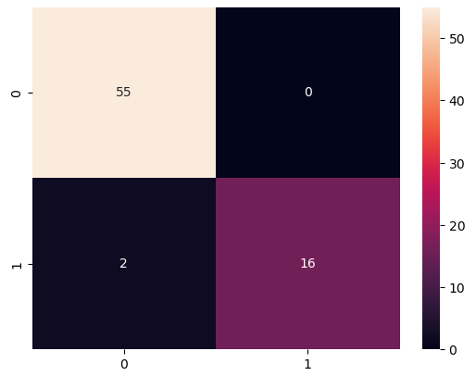
Decision tree & random Forest results
Accuracy :- 97.26%
Precision :- 100%
Recall :- 88.89%
Insight :- Both models achieved perfect precision, but recall could be improved.

Slide 44
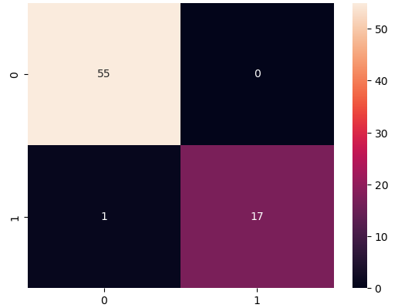
Gradient boosting results
Accuracy :- 98.63%
Precision :- 100%
Recall :- 94.45%
Insight :- Best overall performance-high precision and improved recall.

Slide 45
Model comparison
Model | Accuracy | Precision | Recall
Decision Tree Classifier | 97.26% | 100% | 88.89%
Random Forest Classifier | 97.26% | 100% | 88.89%
Gradient Boosting Classifier | 98.63% | 100% | 94.45%

Slide 46
conclusion
Gradient Boosting delivered the best balance of precision and recall
Feature encoding and age binning improved model interpretability

Slide 47
Thank you

